Slide 1

How can board game makers tell if their products will be highly rated on boardgamegeek.com?
A regression analysis of board game data from Board Game Geek, a board game rating and discussion site.

Slide 2
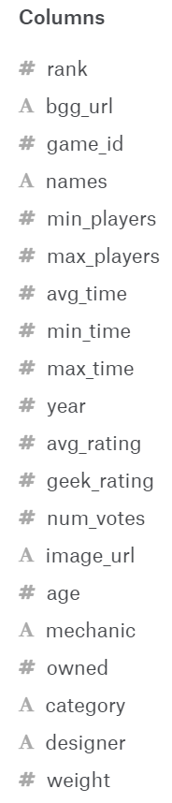
The Data
The data was collected in March of 2017 from the website https://boardgamegeek.com/.
This site has an API to retrieve game information.
The data consists of 5,000 observations of 20 columns.

Slide 3
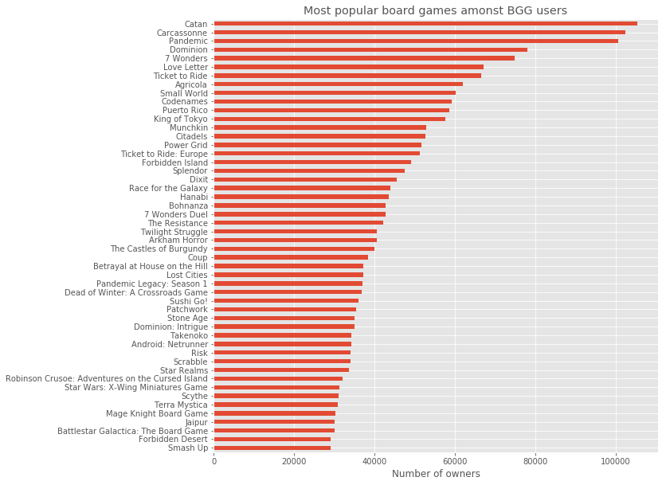
Board Game Geek Bias
Dataset comes from the Board Game Geek website
BGG users are more knowledgeable and invested in board games
Bias is evident since all-time favorites such as Monopoly, Risk, Scrabble are not included
BGG data is a mix of ownership and rating

Slide 4
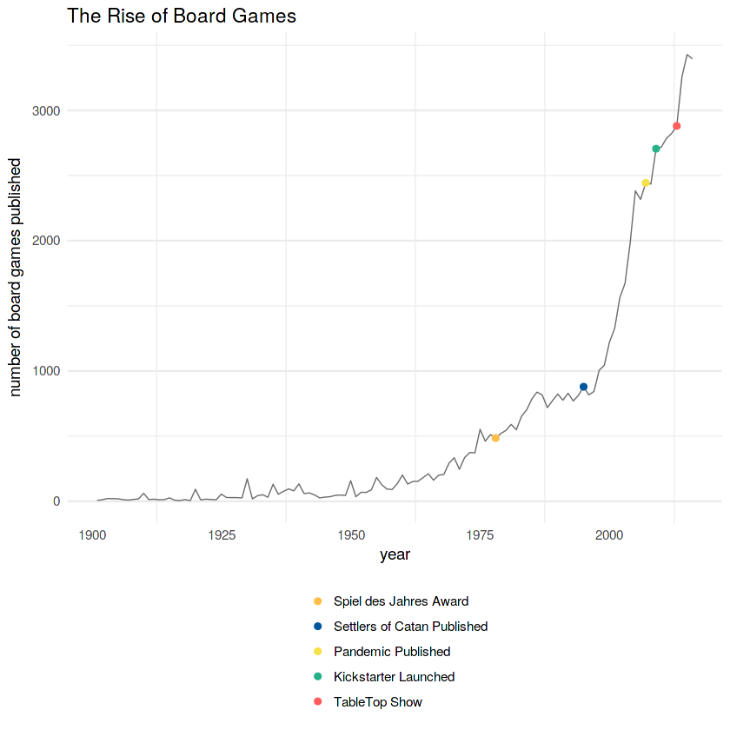
Rise in Board Game Publishing

Slide 5

Klaus Teuber
Creator of Settlers of Catan
Settlers of Catan is BGG’s most popular game by ownership
Has sold over 18 million copies worldwide
4.5 rating on Amazon with over 2,200 ratings despite price point over $100.
Notes:
Klaus was dental technician in Germany who got bored with his job and began developing board games as a hobby.He created the best-selling board game (by ownership on BGG) of all time. Now runs a multi-million dollar company with his family.

Slide 6
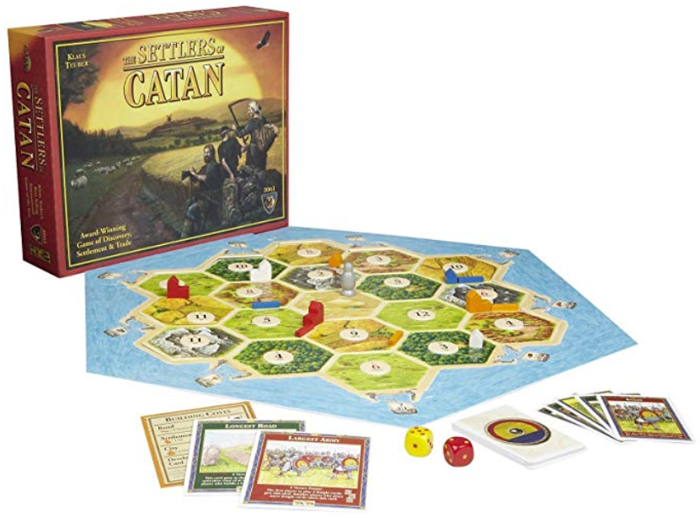
Play time of 90 minutes
Over 83k voters on BGG
Considered fun, engaging, and repeatable - different every time it’s played
More complex than games like Monopoly, Battleship, Connect Four, etc

Slide 7
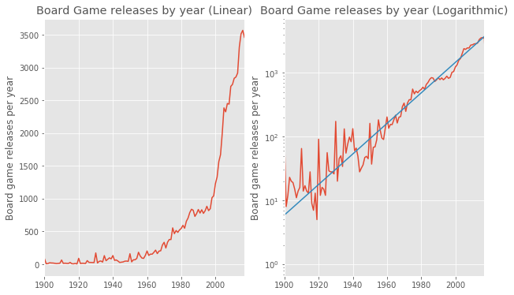
Logarithmic and Linear Regressions
The “hockey stick” linear graph suggests a recent golden age of board games
Notes:
These numbers do not include expansions of existing games!

Slide 8
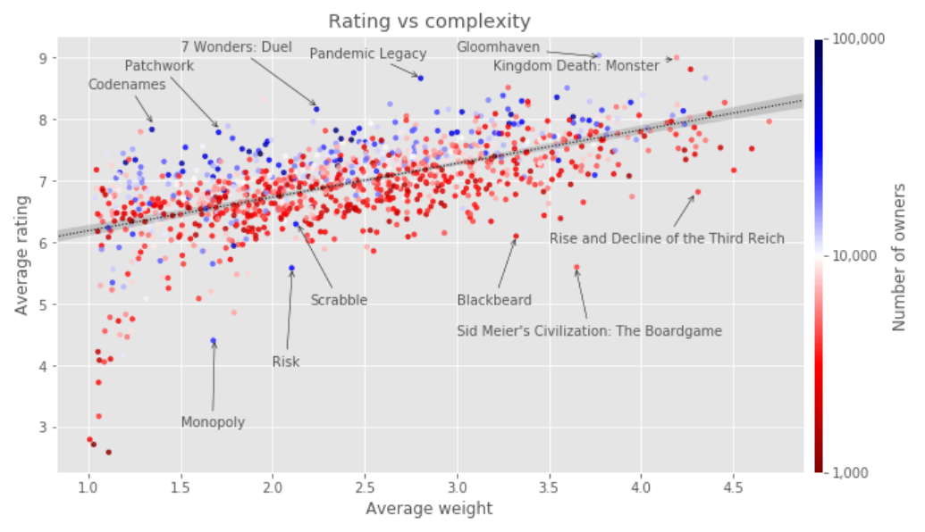
Correlation of Rating to Complexity
There is a pretty clear correlation between how complex a game is and how highly rated it is on BGG.

Slide 9
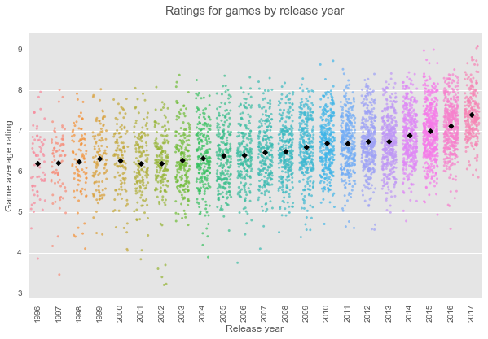
Average Rating by Year Since 1995

Slide 10
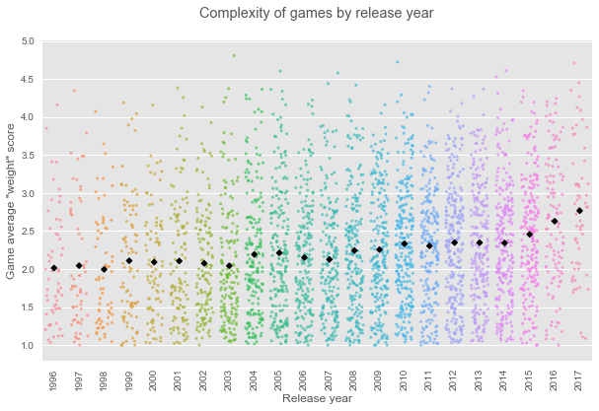
Average Complexity by Year Since 1995
Notes:
Complexity is difficult to define. The ancient Asian game Go is very simple in terms of rules, but the game board has more possible combinations than there are atoms in the universe! For this analysis, the BGG data contains a “weight” score of the games that provides an all-encompassing sense of the complexity of a game, based on users’ perception.

Slide 11
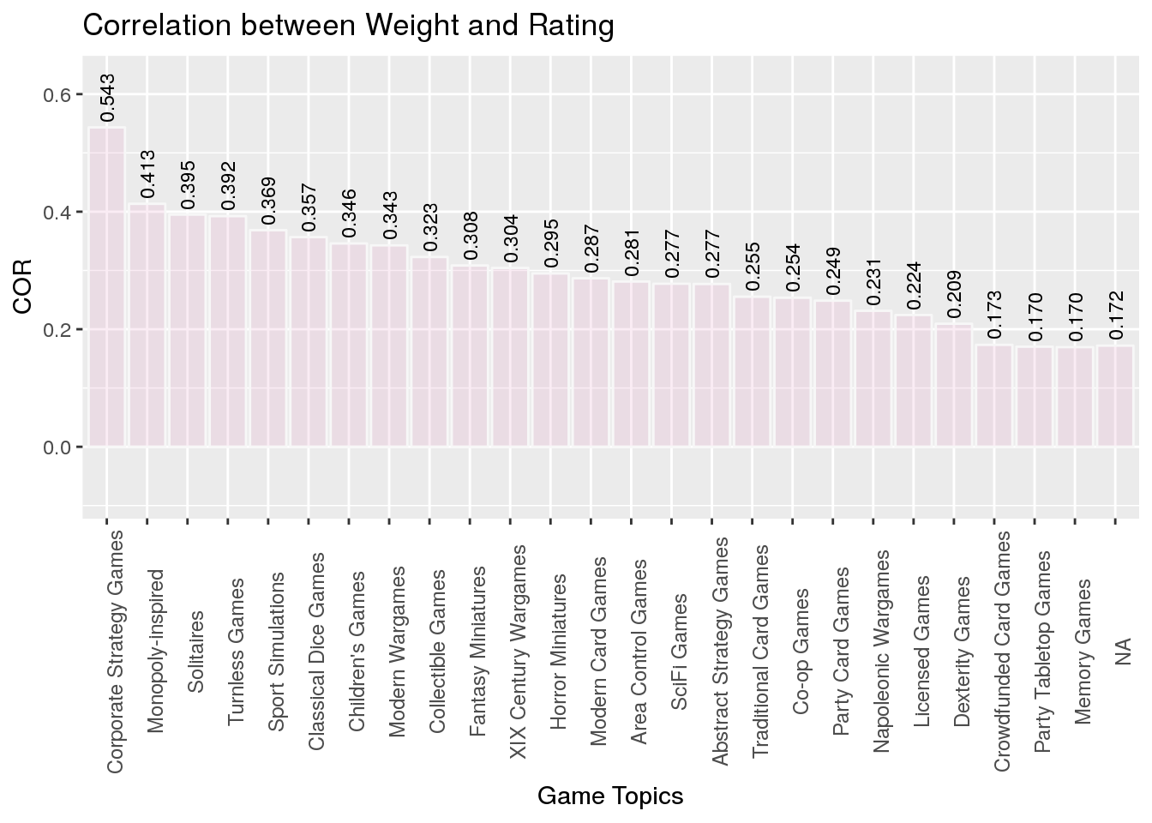
Looking at weight overall, it is clear that it impacts rating. Rating is important because owning a board games is not necessary to play it.

Slide 12
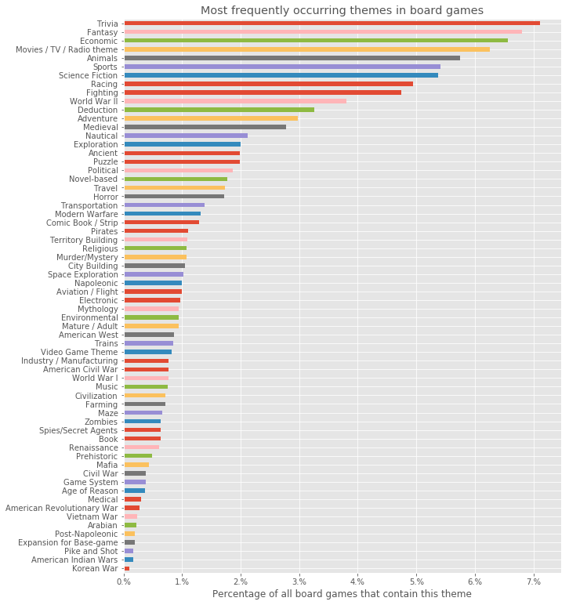
BGG has several levels of taxonomy, but only Type is included here. These are the most prevalent themes.
From a marketing and sales perspective ensuring that a game fits into the most popular theme is a safe move. However, investing in the themes with fast growing popularity may have greater sales potential in an untapped market.
Notes:
Themes are assigned by users. There are several levels of taxonomy. It is important to note that only about a quarter of games have a theme according to BGG’s taxonomy. This analysis is only considering the games that users have given a type.

Slide 13
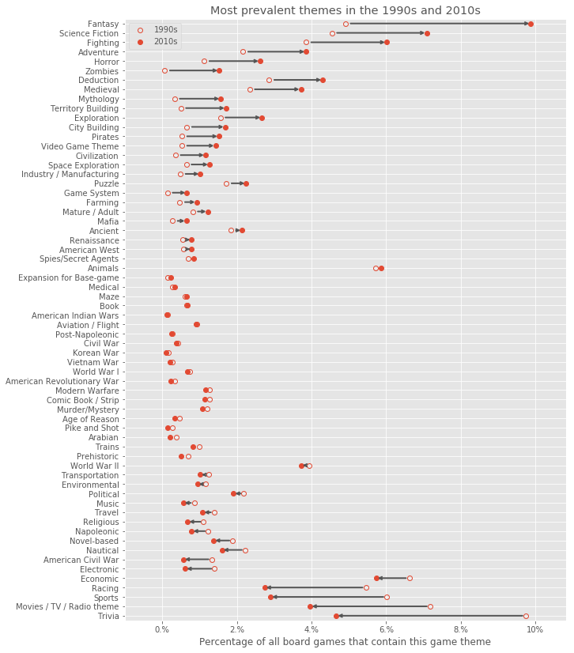
These are the themes that have become more or less popular since 1990.

Slide 14
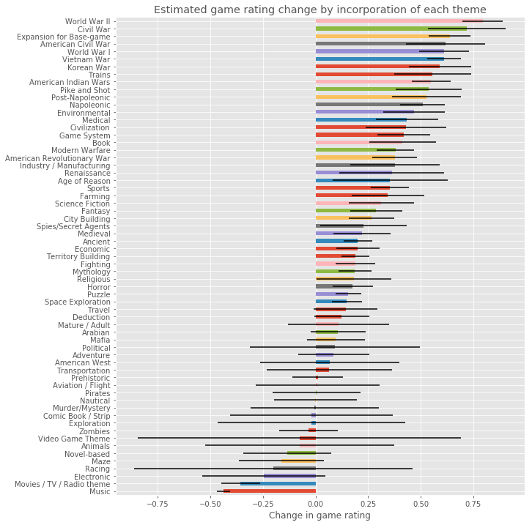
Overlaying game ratings with popularity of themes provides an estimation of how theme might affect popularity. Some themes have a greater range of effect, while others are safe bets. Again, the suggestion is that themes are a potentially good marketing tool.

Slide 15
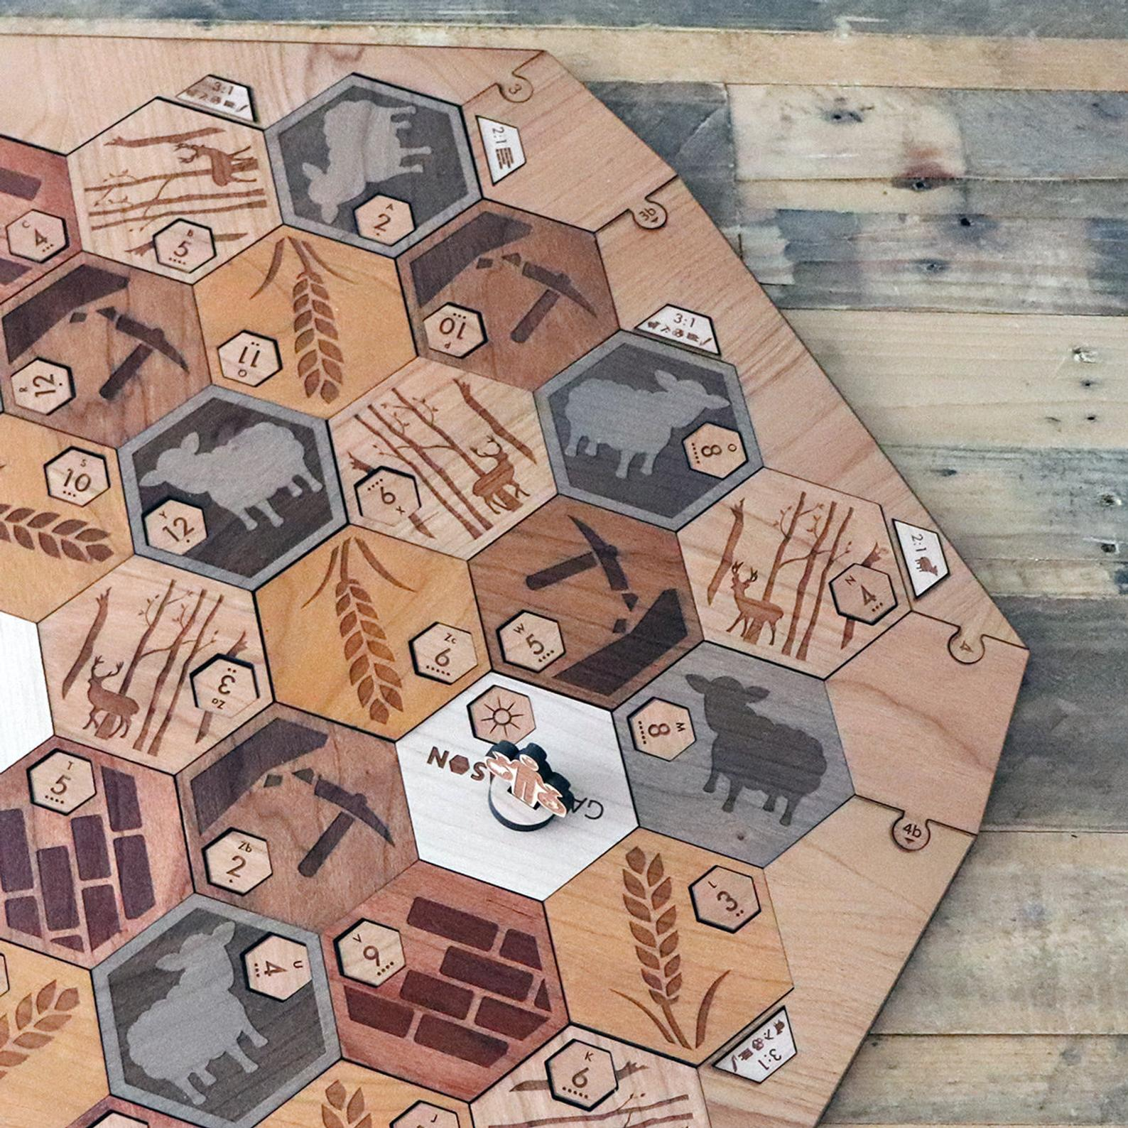
Conclusion
More games are being published each year than ever, and numbers have been increasing since the 1990s.
As complexity has increased, popularity has increased.
Themes and complexity may be good tools for ensuring popularity.
Would recommend a more detail rating scale so BBG could develop game recommendations using collaborative filtering to grow popularity.

